Slide 1
Solving Combinatorial Optimization problems with Neural Nets
Hao Sun
Apr.12, 2019

Slide 2
Outline
From RNN, LSTM to Seq2Seq Models
Pointer Networks
Neural Combinatorial Optimization with RL
Other extensions

Slide 3
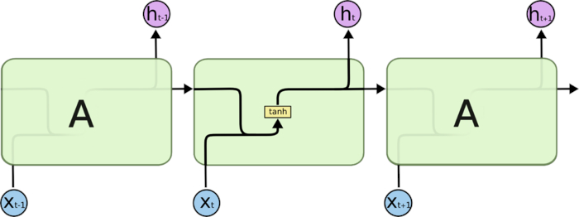
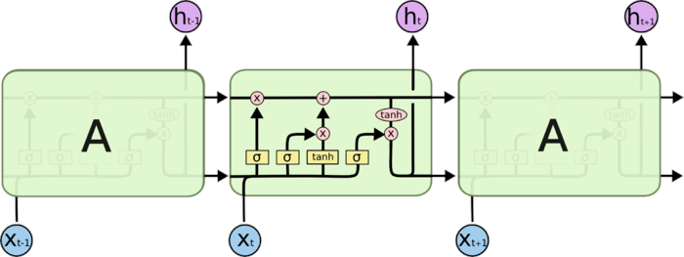
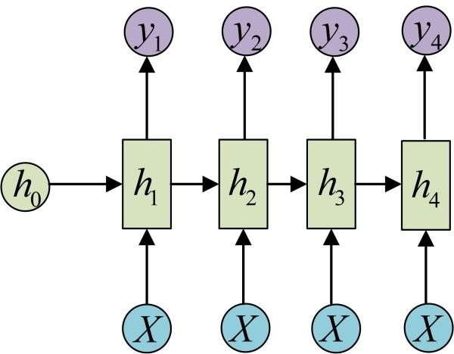
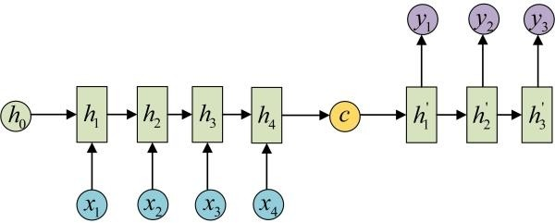
RNNs & LSTMs
Recurrent Neural Nets
seq2seq

Slide 4
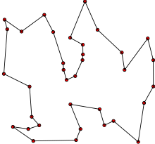
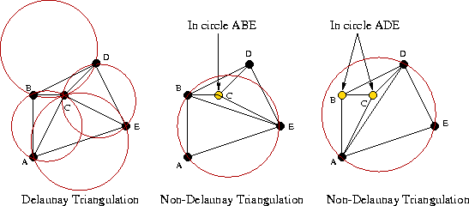
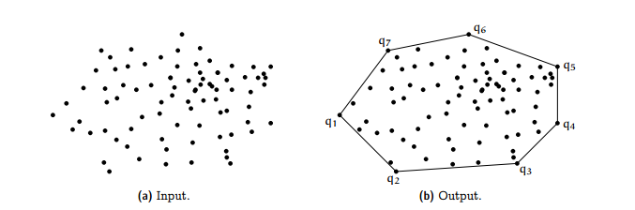
Combinatorial Optimization Problems
Travelling salesman problem(TSP)
Convex Hull
Delaunay Triangulation
P/NP

Slide 5
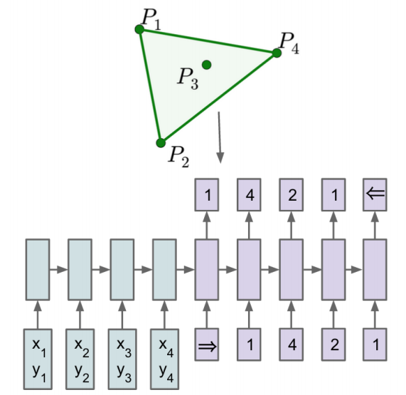
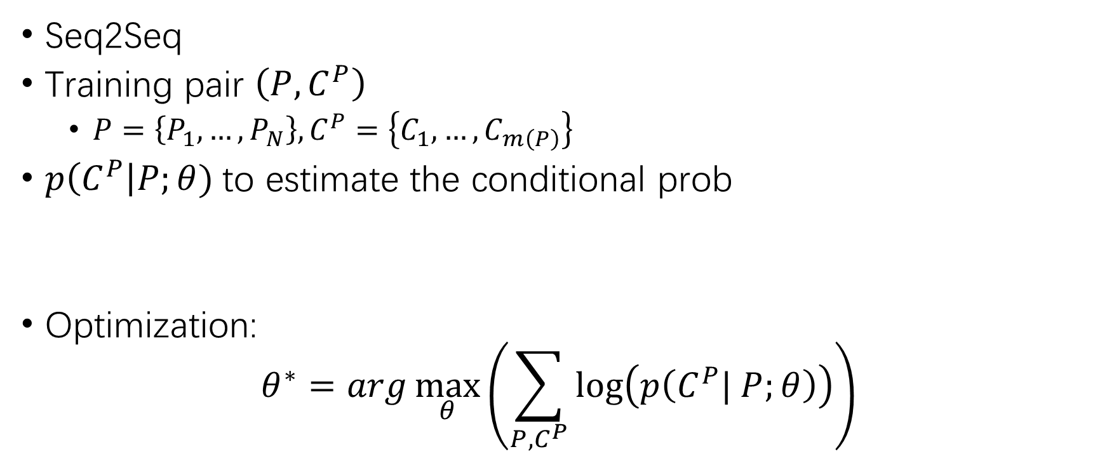
Solving CO by NNs
Seq2Seq
Training pair $\left(P,C^{P}\right)$
$P=\left\{P_{1},…,P_{N}\right\}, C^{P}=\left\{C_{1},…,C_{m\left(P\right)}\right\}$
$p\left(C^{P}\right|P;θ)$to estimate the conditional prob
Optimization:
$$θ^{∗}=arg\max_{θ}\left(\sum_{P,C^{P}}{\log\left(p\left(C^{P}| P;θ\right)\right)}\right)$$

Slide 6
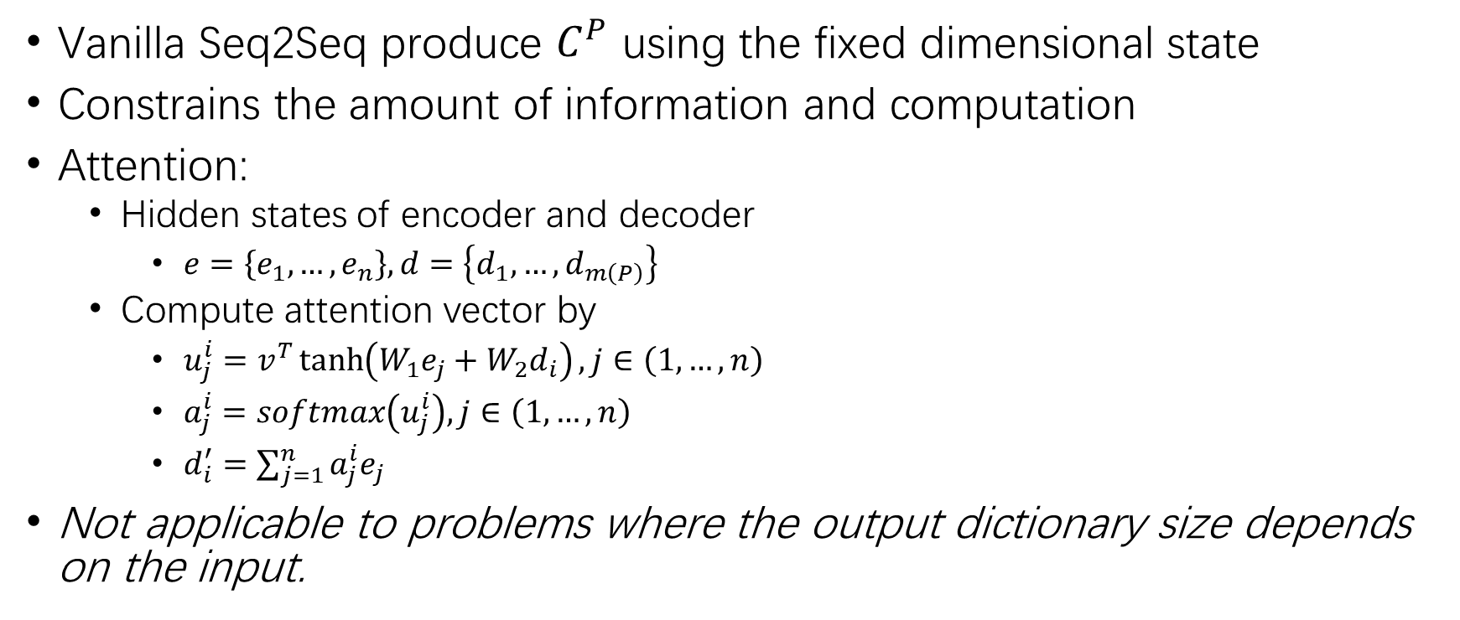
Attention module
Vanilla Seq2Seq produce $C^{P}$ using the fixed dimensional state
Constrains the amount of information and computation
Attention:
Hidden states of encoder and decoder
$e=\left\{e_{1},…,e_{n}\right\}, d=\left\{d_{1},…,d_{m\left(P\right)}\right\}$
Compute attention vector by
$u_{j}^{i}=v^{T}\tanh\left(W_{1}e_{j}+W_{2}d_{i}\right), j∈\left(1,…,n\right)$
$a_{j}^{i}=softmax\left(u_{j}^{i}\right), j∈\left(1,…,n\right)$
$d_{i}^{′}=\sum_{j=1}^{n}{a_{j}^{i}e_{j}}$
Not applicable to problems where the output dictionary size depends on the input.

Slide 7
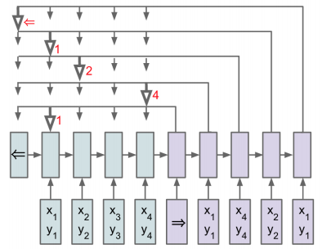

Pointer Networks(PN)
Need
output dictionary size depends on the input
$$\overset{⇔}{ i.e. }$$
PN
outputs are in a subset of inputs
$u_{j}^{i}=v^{T}\tanh\left(W_{1}e_{j}+W_{2}d_{i}\right), j∈\left(1,…,n\right)$
$p\left(C_{i}|C_{1},…,C_{i−1}, P\right)=softmax\left(u^{i}\right)$

Slide 8
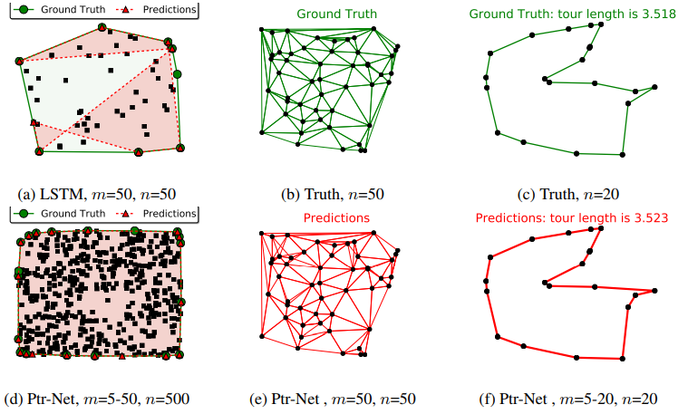
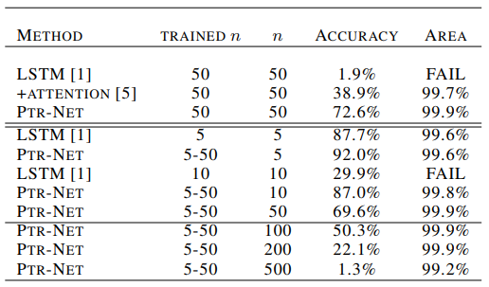
Empirical results
Table: on the convex hull problem

Slide 9
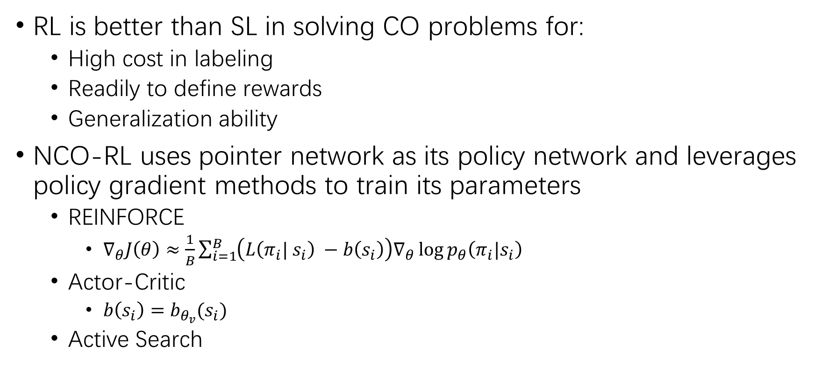
Neural Combinatorial Optimization with RL
RL is better than SL in solving CO problems for:
High cost in labeling
Readily to define rewards
Generalization ability
NCO-RL uses pointer network as its policy network and leverages policy gradient methods to train its parameters
REINFORCE
$∇_{θ}J\left(θ\right)≈\frac{1}{B}\sum_{i=1}^{B}{\left(L\left(π_{i}| s_{i}\right) −b\left(s_{i}\right)\right)∇_{θ}\log{p_{θ}\left(π_{i}|s_{i}\right)} }$
Actor-Critic
$b\left(s_{i}\right)=b_{θ_{v}}(s_{i})$
Active Search

Slide 10
Extensions
Reinforcement learning for solving vehicle routing problem
Non-sequence embedding
Learning Combinatorial Optimization Algorithms over Graphs
Graph embedding
Code:
PointNet:https://github.com/LinyangHe/PyTorch-Pointer-Network-for-Number-Sorting
NCO-RL:https://github.com/higgsfield/np-hard-deep-reinforcement-learning
Graph:https://github.com/Hanjun-Dai/graph_comb_opt

Slide 11
References
Vinyals, Oriol, Meire Fortunato, and Navdeep Jaitly. "Pointer networks." Advances in Neural Information Processing Systems. 2015.
Bello, Irwan, et al. "Neural combinatorial optimization with reinforcement learning." arXiv preprint arXiv:1611.09940(2016).
Nazari, Mohammadreza, et al. "Reinforcement learning for solving the vehicle routing problem." Advances in Neural Information Processing
Khalil, Elias, et al. "Learning combinatorial optimization algorithms over graphs." Advances in Neural Information Processing Systems. 2017.
https://www.zhihu.com/question/43610101

